Slide 1
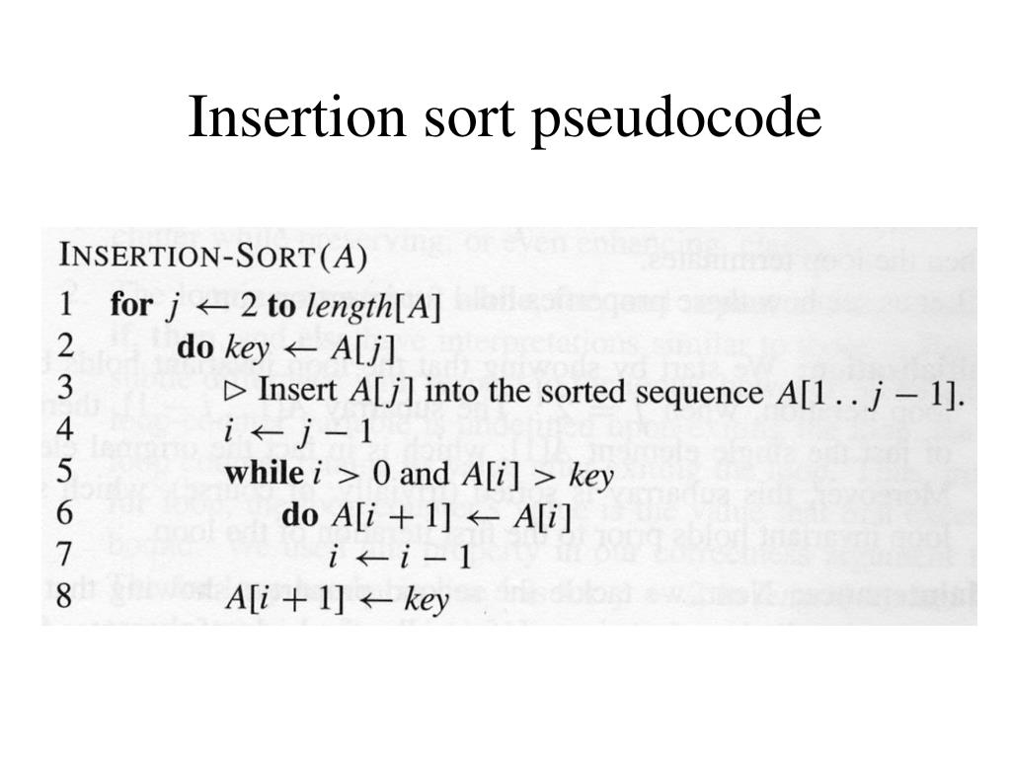
L1.<number>

Slide 2
Example of insertion sort
8
2
4
9
3
6
L1.<number>

Slide 3
Example of insertion sort
8
2
4
9
3
6
L1.<number>

Slide 4
Example of insertion sort
8
2
4
9
3
6
2
8
4
9
3
6
L1.<number>

Slide 5
Example of insertion sort
8
2
4
9
3
6
2
8
4
9
3
6
L1.<number>

Slide 6
Example of insertion sort
8
2
4
9
3
6
2
8
4
9
3
6
2
4
8
9
3
6
L1.<number>

Slide 7
Example of insertion sort
8
2
4
9
3
6
2
8
4
9
3
6
2
4
8
9
3
6
L1.<number>

Slide 8
Example of insertion sort
8
2
4
9
3
6
2
8
4
9
3
6
2
4
8
9
3
6
2
4
8
9
3
6
L1.<number>

Slide 9
Example of insertion sort
8
2
4
9
3
6
2
8
4
9
3
6
2
4
8
9
3
6
2
4
8
9
3
6
L1.<number>

Slide 10
Example of insertion sort
8
2
4
9
3
6
2
8
4
9
3
6
2
4
8
9
3
6
2
4
8
9
3
6
2
3
4
8
9
6
L1.<number>

Slide 11
Example of insertion sort
8
2
4
9
3
6
2
8
4
9
3
6
2
4
8
9
3
6
2
4
8
9
3
6
2
3
4
8
9
6
L1.<number>

Slide 12
Example of insertion sort
8
2
4
9
3
6
2
8
4
9
3
6
2
4
8
9
3
6
2
4
8
9
3
6
2
3
4
8
9
6
2
3
4
6
8
9
done
L1.<number>

Slide 13
Running time
The running time depends on the input: an already sorted sequence is easier to sort.
Major Simplifying Convention: Parameterize the running time by the size of the input, since short sequences are easier to sort than long ones.
  T_{A}(n) = time of A on length n inputs
Generally, we seek upper bounds on the running time, to have a guarantee of performance.
L1.<number>

